Slide 1
Diploma in Packaging Technology
Package Line Operations
Notes:
Introduction
Welcome
Background to FPC
Important contribution to the food industry

Slide 2
Contact
Tony Duffy
tony-duffy@outlook.com
++44(0)7526497265

Slide 3
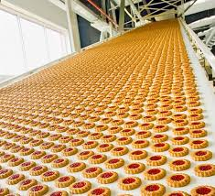
Overview
Line Requirements
Automation
Layout
Efficiency
Inspection

Slide 4
Line Requirements
Group exercise
When deciding on a new packaging line what information is required on
Product
Packaging
Operational requirements
Equipment

Slide 5
Product
Physical format, fragility
Hazards
Hygiene requirements
Variants
Market information

Slide 6
Packaging Materials
Materials
Style, size, tolerances
Stability, fragility,
Variants
Other critical performance indicators

Slide 7
Operational
Output, speed, automation
Run lengths
Space and layout constraints
Labour requirements, skill and numbers
Health & Safety
Time constraints

Slide 8
Equipment
Services & Space
Integration
Training requirements
Lead times and installation
Commissioning & Performance assessment

Slide 9
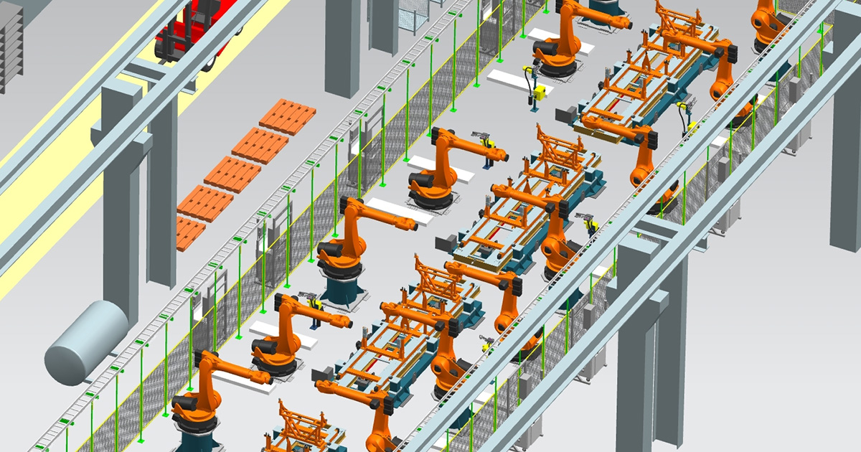
Automation Impact

Slide 10
Automation Impact
Speed, quality, consistency, tolerances, adjustments
Hygiene & safety
Labour and skill requirements
Capital cost
Flexibility
Integration

Slide 11
Production Layout
Process layout (job shop)
Product Layout (production line)
Hybrid
Fixed position

Slide 12
Process layout
Group similar processes together.
Cooking, mixing, chopping
Printing, die cutting, folding gluing
Prioritise workload with available equipment / staff
General machines capable of producing a variety of products
Layout of economic activity centres important

Slide 13
Product layout
Lines for individual products / families
Product flows through production
Resources arranged about product path
Specialized
Straight, U, S,

Slide 14
Hybrid
Fixed Position
Elements of Process and Product
Group technology
Families of products with similar requirements
Technology arranged around product requirements
Product stays in one place
All equipment and parts brought to product

Slide 15
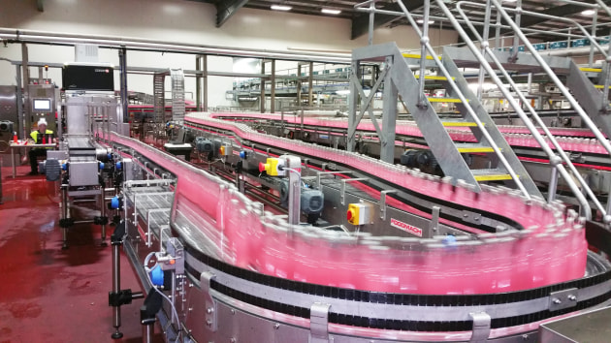
Process evaluation
Issues to consider in process packaging line review.

Slide 16
Process evaluation
Material handling
Production rate
Specialization
Flexibility
Capital expenditure
Work environment
Work in progress
Product variety

Slide 17
Economic activity areas arrangement
Cross contamination
Product, people, air, water, waste
Efficiency
Movement of materials, equipment, people
Storage
Raw materials, work in progress, finished goods, equipment, locations

Slide 18
Economic activity areas arrangement
Space
Routine and non routine tasks.
Work in progress
Circulation
Hygiene
People, equipment, facilities

Slide 19
Filling Lines
Tend to be production lines (product layout)
Separate machines linked together
Balancing speeds
Higher speeds feeding into and out from critical plant (often filler)
Dynamic speed adjustment or on/off

Slide 20
Packaging Line Efficiency
How do we measure line efficiency?
Why do we measure efficiency?
What factors effect line efficiency?

Slide 21
Efficiency
Efficiency
Ration of Output to Input
Operating time to available time
Output rate to target

Slide 22
Equipment Speed
Design speed
Theoretical max speed
Capacity
Upper sustainable limits
Running speed
Instantaneous operating rate
Output rate
Output of acceptable product per given time

Slide 23
Equipment Efficiency
Output required
Running speeds
Wastage
Breaks, product changes
Maintenance & breakdown
Operating / shift pattern

Slide 24
Output
Speed & Machine Operation
50 cpm, at 98% efficiency: 49 cpm
70 cpm at 65% efficiency: 46 cpm

Slide 25
Accumulators
Provide product storage
Isolate key areas
Placed after non interruptible operations
Ovens
Curing
NOT to be used to compensate for defective machines
The third generation of the Accutable (youtube.com)

Slide 26
Accumulators
Space requirements
Sequences
FIFO
LOFO
https://www.youtube.com/watch?v=y6_tuxycJ2M

Slide 27
Line output
Unscrambling: 110 pack/min 96% eff
Filler: 90 pack/min 95% eff
Labeller: 110 pack/min 97% eff
Shrink Wrap: 120 pack/min 92% eff

Slide 28
Line output
Unscrambling: 110 pack/min 96% eff
Filler: 90 pack/min 95% eff
Accumulator
Labeller: 110 pack/min 97% eff
Shrink Wrap: 120 pack/min 92% eff

Slide 29
Line Efficiency
Labeller stopped
Filler can continue to run

Slide 30
Line output
Unscrambling: 110 pack/min 96% eff
Accumulator
Filler: 90 pack/min 95% eff
Labeller: 110 pack/min 97% eff
Shrink Wrap: 120 pack/min 92% eff

Slide 31
Line output
Unscrambling: 110 pack/min 96% eff
Filler: 90 pack/min 95% eff
Labeller: 110 pack/min 97% eff
Accumulator
Shrink Wrap: 120 pack/min 92% eff

Slide 32
Line output
Unscrambling:
Accumulator – Output rate
Filler:
Accumulator – Output rate
Labeller:
Accumulator – Output rate
Shrink Wrap:

Slide 33
Overall Equipment Effectiveness
Linked to total productive maintenance (TPM)
Downtime losses (availability)
Speed losses (performance rate)
Defect loss (quality rate)
OEE = Availability x Performance rate x Quality rate

Slide 34
OEE
Availability (87%)
Examples
Performance (93%)
Examples
Quality (95%)
Examples

Slide 35
Line Speeds
Straight Machines
Indexing to position, single or multi head
Up to 150cpm
Rotary Machines
High speed, large number of heads, compact
Up to 2000cmp

Slide 36
Line speed
Container shape
Shingling
Cylindrical / oval / square
Stability
Base, weight, points of contact
Optimum speed?

Slide 37
Changeovers
From last saleable product to first saleable
Time reduction
Preparation. Parts, tools operators, duplicates
Changeover. No tools,
Set up. Adjustment
Trial. Run up to production speed

Slide 38
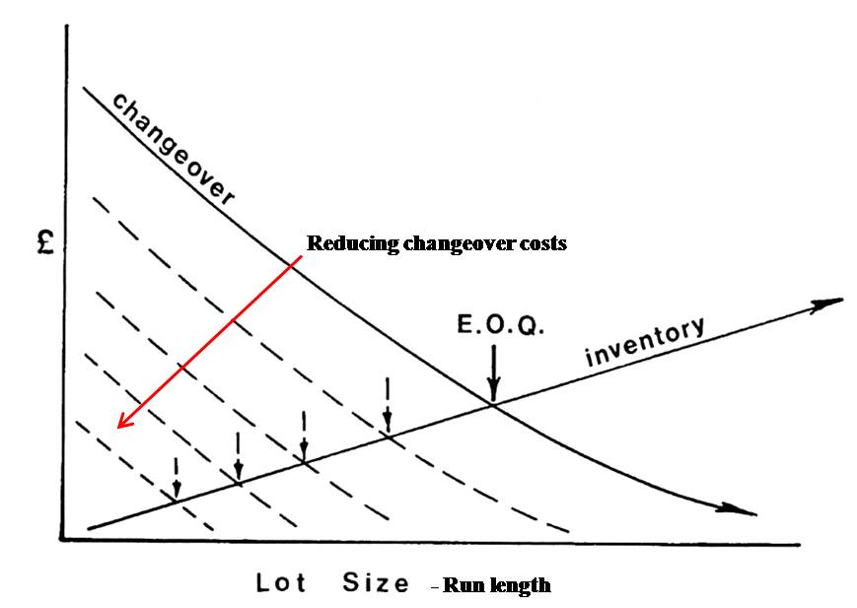
Changeovers
https://www.youtube.com/watch?v=aHSUp7msCIE

Slide 39
Availability
Planned preventative maintenance
Time or work based
Condition based
Opportunity based
Breakdown maintenance
Availability of parts
Damage to products

Slide 40
Quality
Cannot be inspected in
Determine appropriate checks
Monitor process
Feedback to operators
Self inspection

Slide 41
Inspection
Inspection frequency
Product category
Level of risk
Established inspection systems
Inspection cost
Due diligence

Slide 42
Inspection
Weights
Contamination – Foreign body
Leakage
Correct product / pack
Coding & traceability

Slide 43
Other Quality Checks

Slide 44
Online v’s Offline Inspection
Online
100 % inspection
Automated possible
Reliability
Capital
Line speed
Operator training
Offline
Statistical based
Destructive testing
Cost
Training requiement

Slide 45
Inspection Feedback
Statistical Process Control (SPC)
Process capability
Reduction of variation
Not related to product tolerances
Requires action

Slide 46
Overall Equipment Effectiveness
Availability
Performance
Quality
OEE = Availability x Performance rate x Quality rate

